Slide 1


Dmitrii Makhov
04.11.2024

Slide 2

Outline
Executive Summary
Introduction
Methodology
Results
Conclusion
Appendix

Slide 3
Executive Summary
Summary of methodologies
Standard cycle of getting, processing and analysing data.
Summary of all results
Graphs of dependencies of different parameters on each other, a working dashboard for analysis and a predictive classification model.

Slide 4
Introduction
Project background and context
SpaceX advertises Falcon 9 rocket launches on its website, with a cost of 62 million dollars; other providers cost upward of 165 million dollars each, much of the savings is because SpaceX can reuse the first stage.
Problems you want to find answers
I will predict if the Falcon 9 first stage will land successfully. if we can determine if the first stage will land, we can determine the cost of a launch. This information can be used if an alternate company wants to bid against SpaceX for a rocket launch.

Slide 5

Section 1

Slide 6
Methodology
Executive Summary
Data collection methodology:
I will work with data about launching SpaceX collected by SpaceX REST API. I will use URL to target a specific endpoint of the API to get past launch data. Using the method get request I will get data in JSON format which I save in dataframe for future wrabgling.
Perform data wrangling
Using different Python liblaries I will prepare target data by cleaning data from NA and zero values.
Perform exploratory data analysis (EDA) using visualization and SQL
Perform interactive visual analytics using Folium and Plotly Dash
Perform predictive analysis using classification models
I will spit data into training and test sets, proceed this data with different kind of classification models and choose the best model by the statistical estimation parameters.

Slide 7
Data Collection
Describe how data sets were collected.
The data sets were gathered via the SpaceX REST API by making GET requests to specific endpoints for past launches. This returned data in JSON format, which was then loaded into a DataFrame for easy manipulation and analysis. This approach provides up-to-date and detailed information directly from SpaceX’s records.
You need to present your data collection process use key phrases and flowcharts
API Access
Endpoint Targeting
GET Request
Data Loading
Data Storage

Slide 8
Data Collection – SpaceX API
Import Libraries and Define Auxiliary Functions
launch data from SpaceX API with the URL "https://api.spacexdata.com/v4/launches/past"
Getting data by method “get request”
Present your data collection with SpaceX REST calls using key phrases and flowcharts
Add the GitHub URL of the completed SpaceX API calls notebook (https://github.com/Domofon108/DS_Capstone/blob/main/jupyter-labs-spacex-data-collection-api-v2%20(1).ipynb), as an external reference and peer-review purpose

Slide 9
Data Collection - Scraping
import required packages
Request the Falcon9 Launch Wiki page from its URL
Extract all column/variable names from the HTML table header
Using BeautifulSoup
Create a data frame by parsing the launch HTML tables
Present your web scraping process using key phrases and flowcharts
Add the GitHub URL of the completed web scraping notebook, as an external reference and peer-review purpose (https://github.com/Domofon108/DS_Capstone/blob/main/jupyter-labs-webscraping%20(1).ipynb )

Slide 10
Data Wrangling
Describe how data were processed
You need to present your data wrangling process using key phrases and flowcharts
Add the GitHub URL of your completed data wrangling related notebooks, as an external reference and peer-review purpose (https://github.com/Domofon108/DS_Capstone/blob/main/labs-jupyter-spacex-Data%20wrangling-v2%20(1).ipynb)
Import Libraries and Define Auxiliary Functions
Data Analysis
Calculation the number of launches on each site
Loading datasets
Identify and calculate the percentage of the missing values in each attribute
Identify which columns are numerical and categorical
Calculation the number and occurrence of each orbit
Calculation the number and occurence of mission outcome of the orbits
Creation a landing outcome label from Outcome column

Slide 11
EDA with Data Visualization
Summarize what charts were plotted and why you used those charts
Here were presented the next charts which are necessary for determine dependencies and trends:
Visualize the relationship between Flight Number and Launch Site
Visualize the relationship between Payload and Launch Site
Visualize the relationship between success rate of each orbit type
Visualize the relationship between FlightNumber and Orbit type
Visualize the relationship between Payload and Orbit type
Visualize the launch success yearly trend
Add the GitHub URL of your completed EDA with data visualization notebook, as an external reference and peer-review purpose (https://github.com/Domofon108/DS_Capstone/blob/main/jupyter-labs-eda-dataviz-v2%20(1).ipynb)

Slide 12
EDA with SQL
Using bullet point format, summarize the SQL queries you performed
Here were presented the next SQL queries:
The names of the unique launch sites in the space mission; 5 records where launch sites begin with the string 'CCA’;
the total payload mass carried by boosters launched by NASA (CRS),
Average payload mass carried by booster version F9 v1.1;
List the date when the first succesful landing outcome in ground pad was acheived.;
List the names of the boosters which have success in drone ship and have payload mass greater than 4000 but less than 6000;
List the total number of successful and failure mission outcomes;
List the names of the booster_versions which have carried the maximum payload mass;
ist the records which will display the month names, failure landing_outcomes in drone ship ,booster versions,
launch_site for the months in year 2015;
Rank the count of landing outcomes (such as Failure (drone ship) or Success (ground pad)) between the date 2010-06-04 and 2017-03-20, in descending order;
Add the GitHub URL of your completed EDA with SQL notebook, as an external reference and peer-review purpose (https://github.com/Domofon108/DS_Capstone/blob/main/jupyter-labs-eda-sql-coursera_sqllite%20(1).ipynb)

Slide 13
Build an Interactive Map with Folium
Summarize what map objects such as markers, circles, lines, etc. you created and added to a folium map
Marking all launch sites on a map
Marking the success/failed launches for each site on the map
Calculation the distances between a launch site to its proximities
Explain why you added those objects
The launch success rate may depend on many factors such as payload mass, orbit type, and so on. It may also depend on the location and proximities of a launch site, i.e., the initial position of rocket trajectories. Finding an optimal location for building a launch site certainly involves many factors and hopefully we could discover some of the factors by analyzing the existing launch site locations.
Add the GitHub URL of your completed interactive map with Folium map, as an external reference and peer-review purpose (https://github.com/Domofon108/DS_Capstone/blob/main/lab-jupyter-launch-site-location-v2(1).ipynb)

Slide 14
Build a Dashboard with Plotly Dash
Summarize what plots/graphs and interactions you have added to a dashboard
Launch Site Drop-down Input Component
Range Slider to Select Payload
A callback function to render success-pie-chart based on selected site dropdown
A callback function to render the success-payload-scatter-chart scatter plot
Explain why you added those plots and interactions
Plotly Dash application for users to perform interactive visual analytics on SpaceX launch data in real-time.
Add the GitHub URL of your completed Plotly Dash lab, as an external reference and peer-review purpose (https://github.com/Domofon108/DS_Capstone/blob/main/spacex_dash_app.py)

Slide 15
Predictive Analysis (Classification)
Summarize how you built, evaluated, improved, and found the best performing classification model
You need present your model development process using key phrases and flowchart
Add the GitHub URL of your completed predictive analysis lab, as an external reference and peer-review purpose (https://github.com/Domofon108/DS_Capstone/blob/main/SpaceX-Machine-Learning-Prediction-Part-5-v1.ipynb)
Loading the dataframe
Creation NumPy arrays and Standardize the data in X
Data spliating into test and train sets
Creation models
Cross validation models and choosing the best

Slide 16
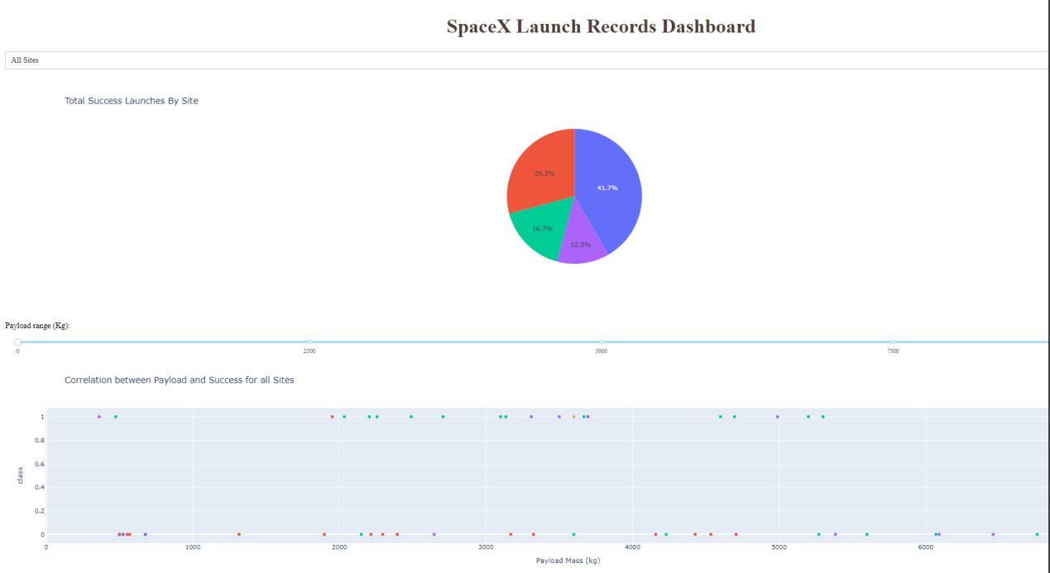
Results
Exploratory data analysis results
Data on the launches of SpaceX company rockets, in particular the Falcon 9 rocket, were analyzed.
Interactive analytics demo in screenshots
Predictive analysis results
Various classification models were constructed and the quality of these models was assessed.

Slide 17

Section 2

Slide 18
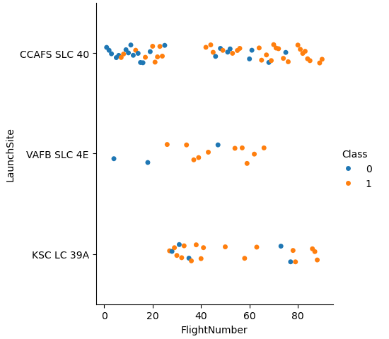
Flight Number vs. Launch Site
Show a scatter plot of Flight Number vs. Launch Site
Show the screenshot of the scatter plot with expl
Introducing of Launch Site depended by Flight Number.
Class = 1 – successful launch
Class = 0 – unsuccessful launch

Slide 19
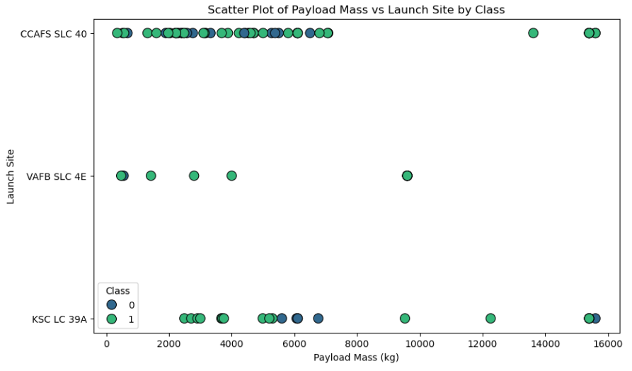
Payload vs. Launch Site
Show a scatter plot of Payload vs. Launch Site
Show the screenshot of the scatter plot with explanations
Introducing of Launch Site depended by plot of Payload
Class = 1 – successful launch
Class = 0 – unsuccessful launch

Slide 20
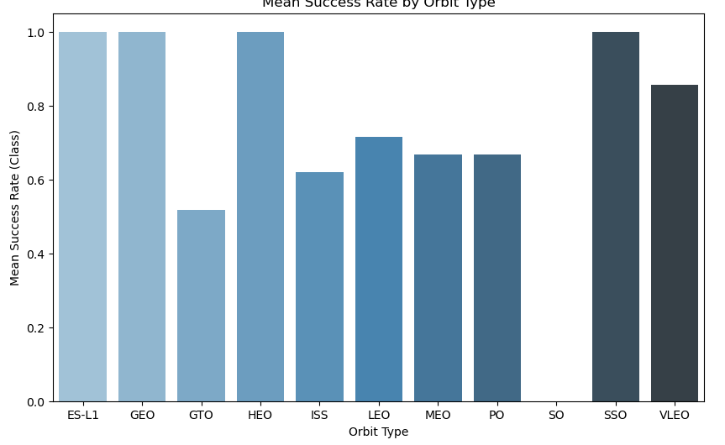
Success Rate vs. Orbit Type
Show a bar chart for the success rate of each orbit type
Show the screenshot of the scatter plot with explanations
Visualize the relationship between success rate of each orbit type

Slide 21
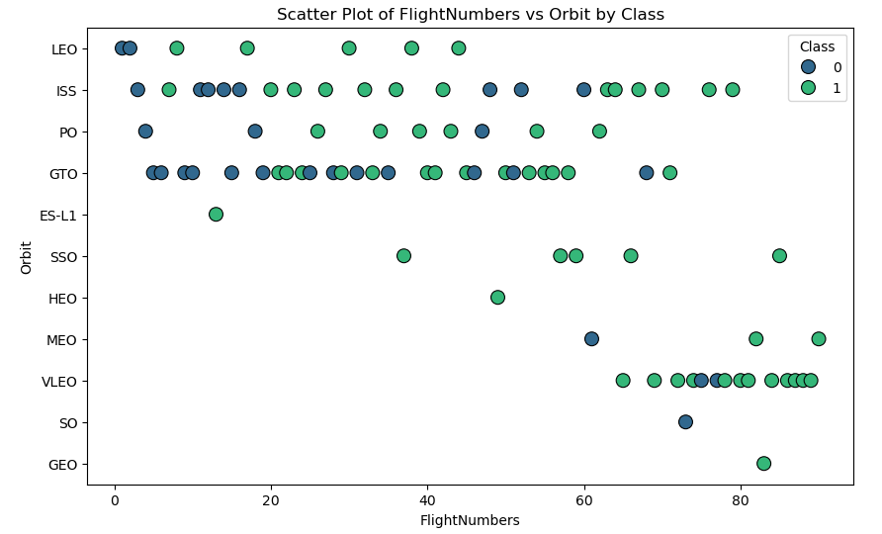
Flight Number vs. Orbit Type
Show a scatter point of Flight number vs. Orbit type
Show the screenshot of the scatter plot with explanations
Visualize the relationship between FlightNumber and Orbit type
Class = 1 – successful launch
Class = 0 – unsuccessful launch

Slide 22
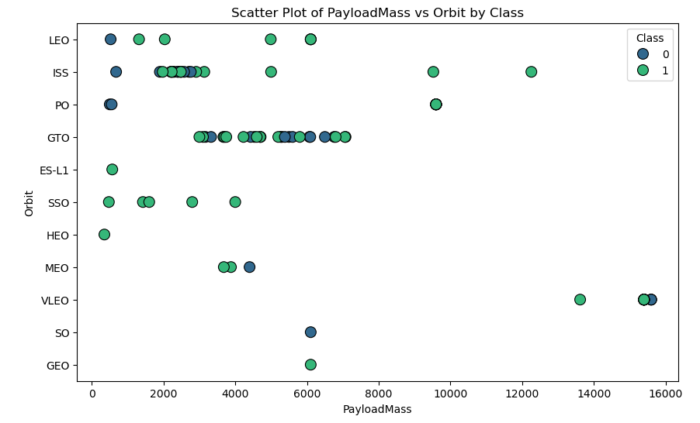
Payload vs. Orbit Type
Show a scatter point of payload vs. orbit type
Show the screenshot of the scatter plot with explanations
Visualize the relationship between Payload and Orbit type
Class = 1 – successful launch
Class = 0 – unsuccessful launch

Slide 23
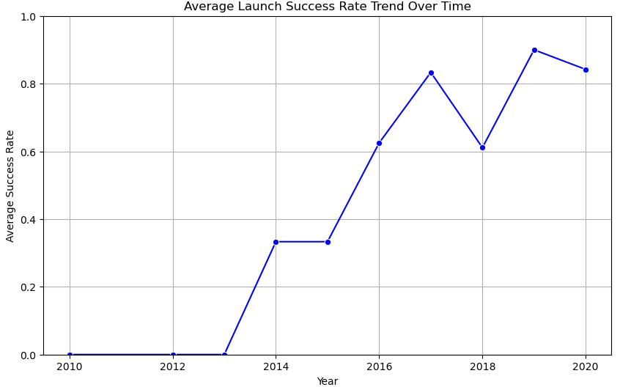
Launch Success Yearly Trend
Show a line chart of yearly average success rate
Show the screenshot of the scatter plot with explanations
Visualize the launch success yearly trend

Slide 24
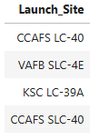
All Launch Site Names
Find the names of the unique launch sites
Present your query result with a short explanation here

Slide 25
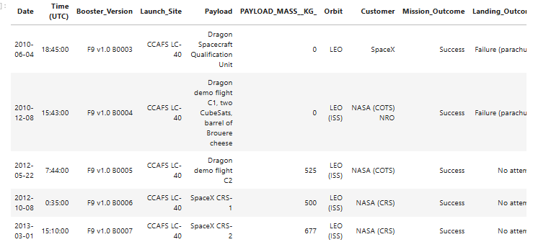
Launch Site Names Begin with 'CCA'
Find 5 records where launch sites begin with `CCA`
Present your query result with a short explanation here

Slide 26
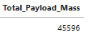
Total Payload Mass
Calculate the total payload carried by boosters from NASA
Present your query result with a short explanation here

Slide 27
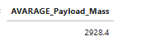
Average Payload Mass by F9 v1.1
Calculate the average payload mass carried by booster version F9 v1.1
Present your query result with a short explanation here

Slide 28
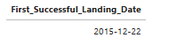
First Successful Ground Landing Date
Find the dates of the first successful landing outcome on ground pad
Present your query result with a short explanation here

Slide 29
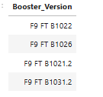
Successful Drone Ship Landing with Payload between 4000 and 6000
List the names of boosters which have successfully landed on drone ship and had payload mass greater than 4000 but less than 6000
Present your query result with a short explanation here

Slide 30
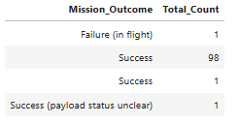
Total Number of Successful and Failure Mission Outcomes
Calculate the total number of successful and failure mission outcomes
Present your query result with a short explanation here

Slide 31
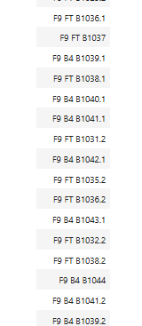
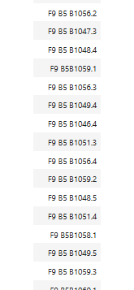
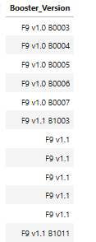
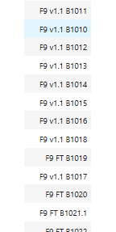
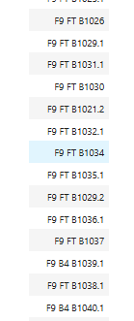
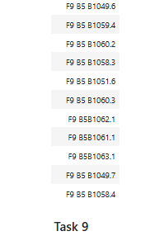
Boosters Carried Maximum Payload
List the names of the booster which have carried the maximum payload mass
Present your query result with a short explanation here (presented only part because list is too huge)

Slide 32
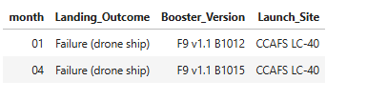
2015 Launch Records
List the failed landing_outcomes in drone ship, their booster versions, and launch site names for in year 2015
Present your query result with a short explanation here

Slide 33
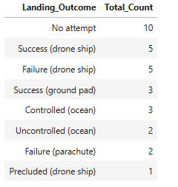
Rank Landing Outcomes Between 2010-06-04 and 2017-03-20
Rank the count of landing outcomes (such as Failure (drone ship) or Success (ground pad)) between the date 2010-06-04 and 2017-03-20, in descending order
Present your query result with a short explanation here

Slide 34

Section 3

Slide 35
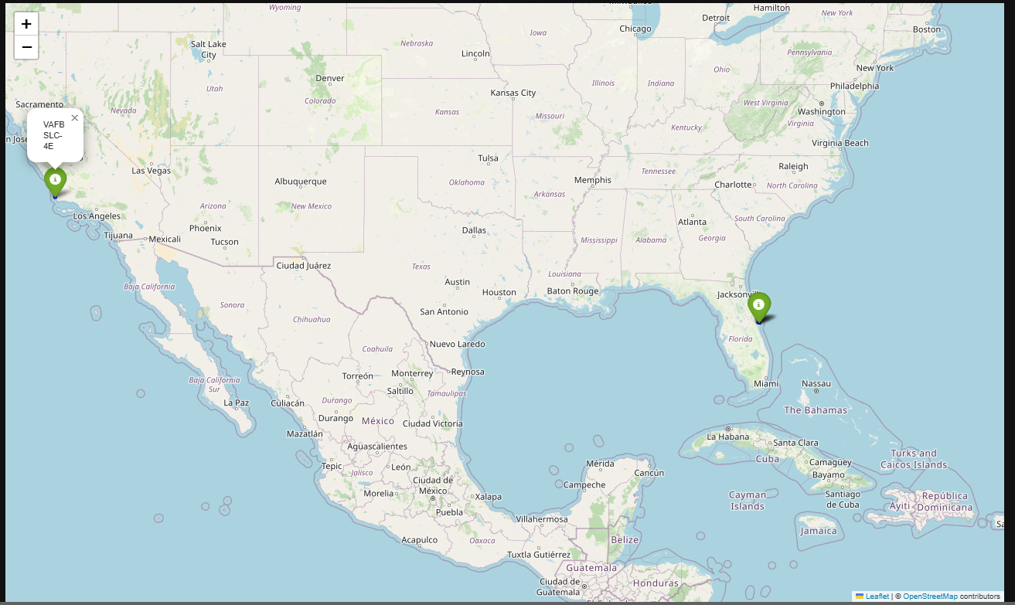
Folium Map for each launch site on the site map

Slide 36
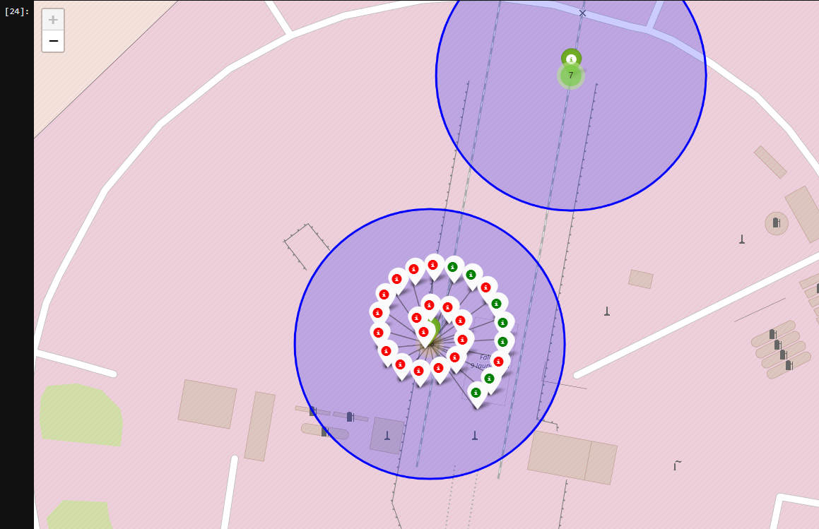
All starts on a one launch Site
Red marker — unsuccessful launch
Green marker — successful launch

Slide 37
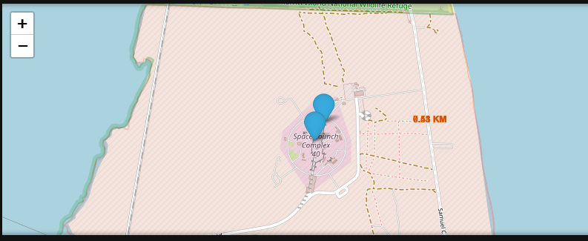
Folium Map distance to closer highway

Slide 38

Section 4

Slide 39
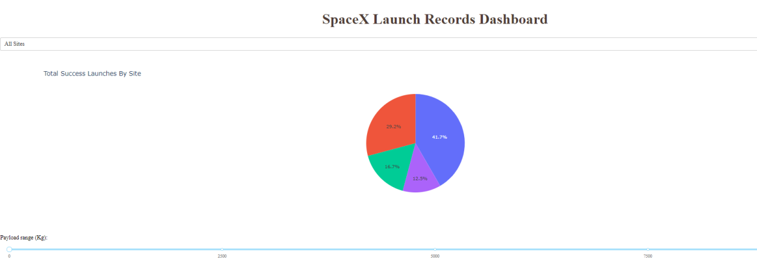
Dashboard. launch success count for all sites

Slide 40
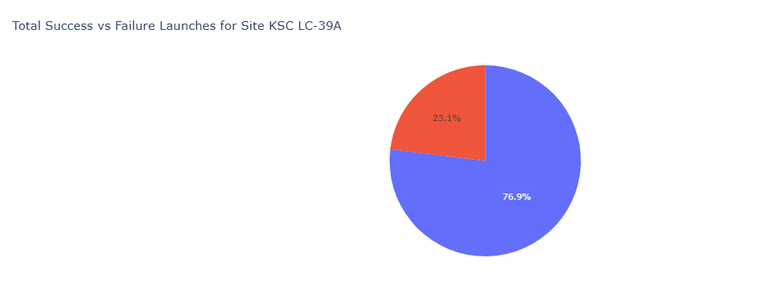
Dashboard. The piechart for the launch site with highest launch success ratio

Slide 41
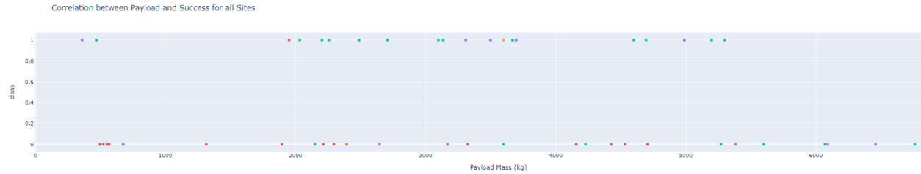
Dashboard. Payload vs. Launch Outcome scatter plot for all sites>

Slide 42

Section 5

Slide 43
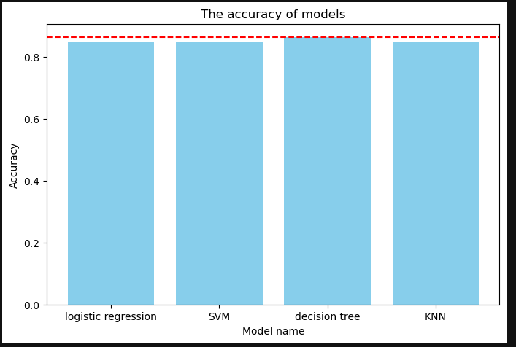
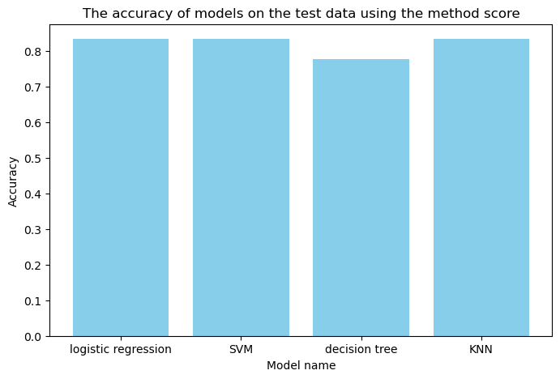
Classification Accuracy
Visualize the built model accuracy for all built classification models, in a bar chart
Find which model has the highest classification accuracy
The best model is Decision Tree with accuracy 86 %
Other models are better with accuracy 84 % by testing data

Slide 44
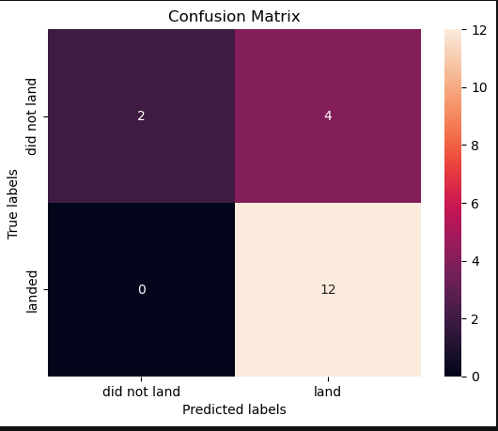
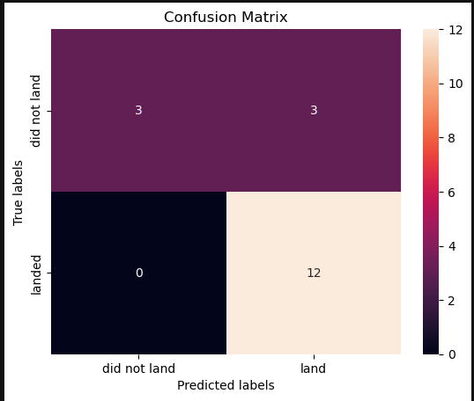
Confusion Matrix
Others
Decision tree

Slide 45
Conclusions
I analyzed the data on successful/unsuccessful rocket launches Falcon 9
Created classification predictive models and chosen the best.
Created Dashboard for online analasing data

Slide 46
Appendix
Link on GitHub project here. https://github.com/Domofon108/DS_Capstone.git

Slide 47


